Slide 1
Hybrid Identity – PHS, PTA & Federated
M365 – MS 100
Notes:
Importance planning

Slide 2
Topics
Hybrid Identity
Password Hash synchronization
Passthrough Authentication
Federation
Notes:
Picture

Slide 3










Hybrid Identity
Allows you to manage your identity from on-premises active directory
Password hash synchronization (PHS)
Pass-through authentication (PTA)
Federated authentication
Your Organization
Microsoft 365
Domain Controller
directory synchronization
Copy of user
Azure AD
Server running
Azure AD Connect
On-premises users
Remote User

Slide 4
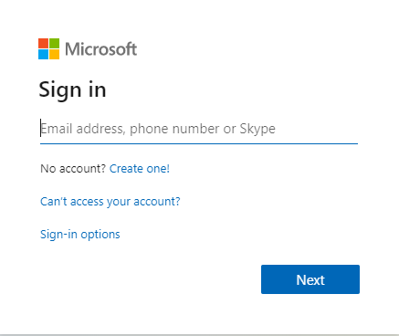
Password hash synchronization (PHS)
With PHS, you synchronize your AD DS user accounts with Microsoft 365
manage your users on-premises
Hashes of user passwords are synchronized from your AD DS to Azure AD
simplest way to enable authentication for AD DS identities in Azure AD.
Your Organization
Microsoft 365
Domain Controller
Copy of user accounts and Hash of password
Azure AD
Server running
Azure AD Connect
On-premises users

Slide 5

Hash value – Password
Ex: password@2020
Converted
Hash value of password
Ex: x1239rewfasdjdn
Stored Hash value of password
Ex: x1239rewfasdjdn
One way function
Validated
Hashing Algorithm
Local Database

Slide 6


Pass-through authentication (PTA)
password validation for Azure AD authentication services using a software agent running on on-premises
Validate the users directly with your AD DS
With PTA, you synchronize AD DS user accounts with Microsoft 365 and manage your users on-premises.
Your Organization
Microsoft 365
Accounts
Domain Controller
Copy of user accounts
Azure AD
Server running
Azure AD Connect
On-premises users

Slide 7
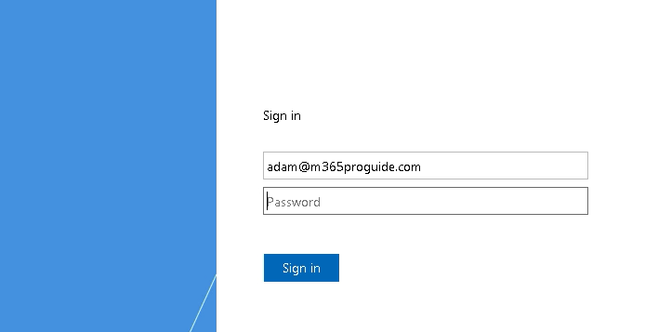
Federated authentication
For large enterprise organizations with more complex authentication requirements
Azure AD redirects the client computer requesting authentication to another identity provider.
With PTA, you synchronize AD DS user accounts with Microsoft 365 and manage your users on-premises.
AD DS identities are synchronized with Microsoft 365 and users accounts are managed on-premises.
Your Organization
Microsoft 365
Accounts
Federation trust
Domain Controller
AD FS Server
Copy of user accounts
Azure AD
Server running
Azure AD Connect
On-premises users

Slide 8
Next Video
Hybrid Identity Model
Password hash synchronization
Pass-through authentication
Federated authentication
Summary
Azure AD Connect

Slide 9
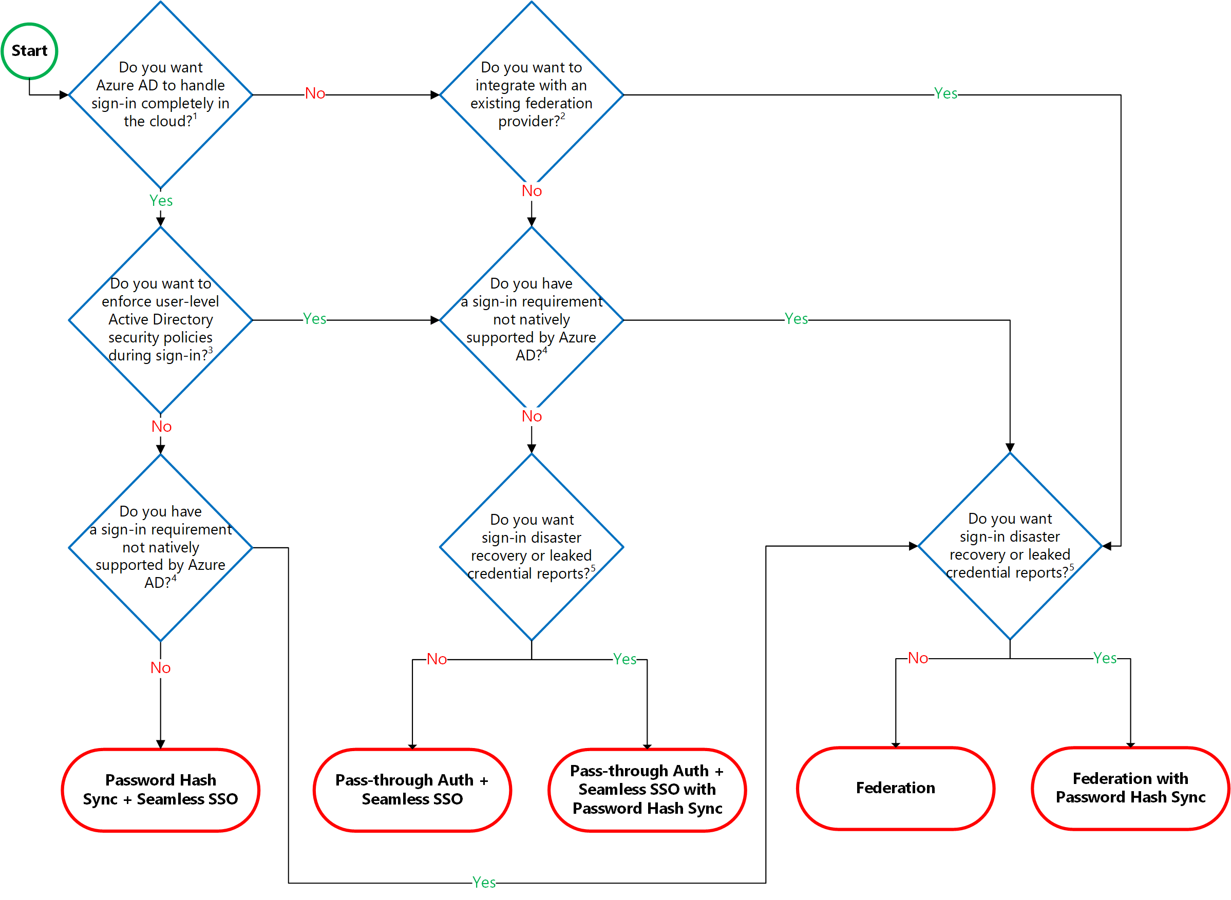
Decision Tree

